Slide 1
Session 1 - Overview
In this first session you will be asked to complete two tasks:
A reaction time task and a declarative binding task.
Before each of the two tasks begins, the relevant task will be explained to you in detail.
Please don‘t use any external devices, materials, notes or similar to complete the tasks.
In each task you will be asked to respond with a certain key.
Therefore, there is a short finger check before each task
so that your fingers are placed on the correct keyboard keys as shown in the images.
Please try your best to complete the tasks.
Once you finish the experiment, your data will be automatically saved
and you will be redirected to Prolific to complete your participation.
Hence, please don‘t refresh or close your browser window prematurely!
In the following, the first task, the reaction time task, is explained.

Slide 2
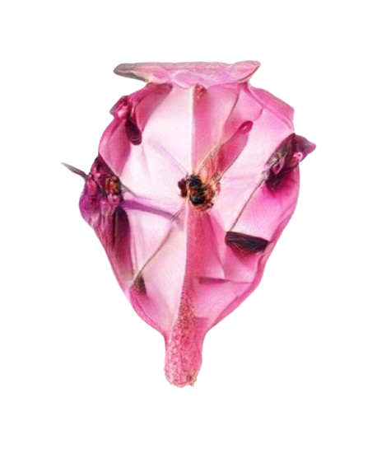

Reaction Time - Task
These are the instructions for the first of two tasks,
the reaction time task.
In this task you will be shown an object in each trial.
Please press the answer key corresponding to the object as quickly as possible.
If a finger is marked with an object at the top, then this is the correct answer key.
In order to be able to continue with the study,
please make sure to reach an accuracy of 75%.
In the following, the task is explained to you in detail, please read the instructions carefully!
Object
Answer keys

Slide 3
Answer Keys
S
D
J
F
H
K
A
L
Here you can see the assignment of the answer keys to the respective fingers.
This key assignment to the fingers remains the same throughout the entire experiment.
Before starting the experiment, please place your fingers on the corresponding keys in the arrangement shown!
Careful: The arrangement is not according to the 10-finger-method.
The left and right index fingers are placed on the “F” and “H” key respectively.
If a finger is marked with the corresponding object, this is the correct answer key for this object.
This assignment of the shapes to the answer keys changes for each trial!
On the next slides follows a detailed example of a trial of the experiment!

Slide 4
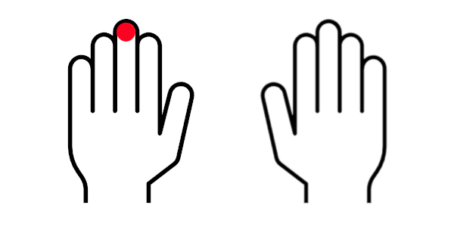


Finger Check
Before the task, you will be asked to complete a short finger check to check the position of your fingers on the keyboard. On each trial fingers are shown, one of which is marked with a red circle. Please press the key corresponding to the finger that is marked with a red circle.
When you pass the finger check, the task will immediately follow. You have 3 tries to pass the check.
Example:
Press this key
Time

Slide 5
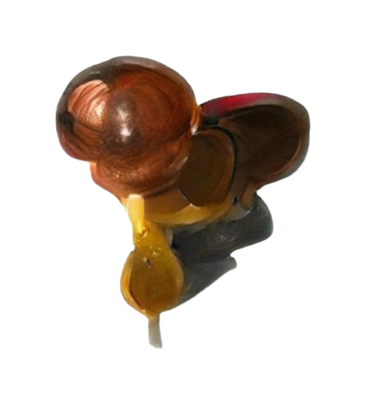

Trial
In each trial, you are first shown the key assignment of the objects. If a finger is marked with the corresponding object, then this is the correct key for these objects.
Example:
Time

Slide 6
Trial
Shortly after, you will be presented with an object. When the object is displayed, you should press the key for the corresponding object as quickly as possible.
Example:
Press this key
Time

Slide 7
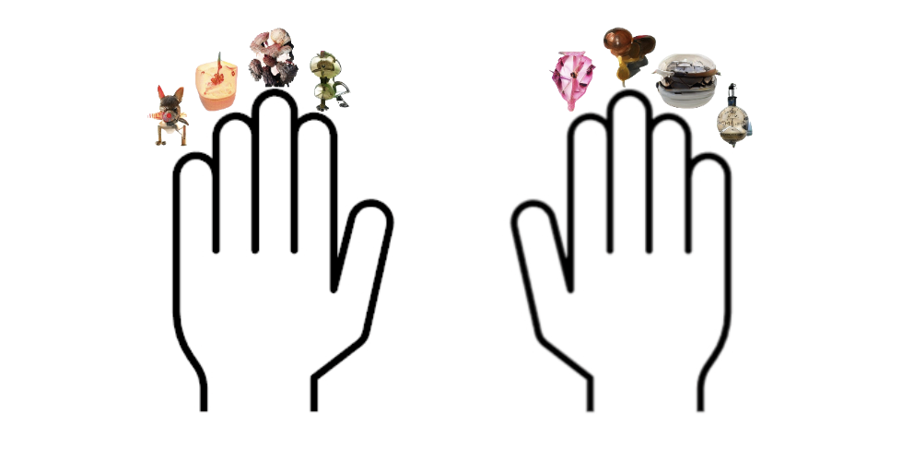
Trial
In the next trial, you will now be shown a new key assignment of the objects.
Example:
Time

Slide 8
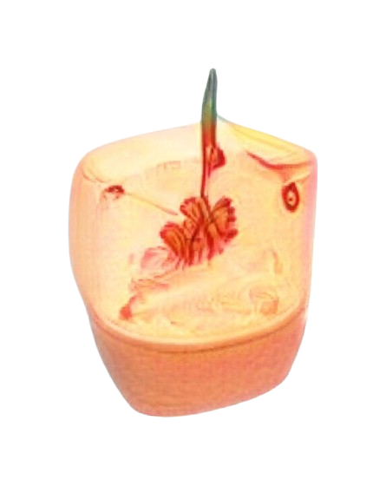
Trial
After that, the next object will be shown to you. As soon as the object appears, please press the key of the corresponding object again as quickly as possible.
Example:
Press this key
Time

Slide 9

Trial
Another key assignment of objects appears.
Example:
Time

Slide 10
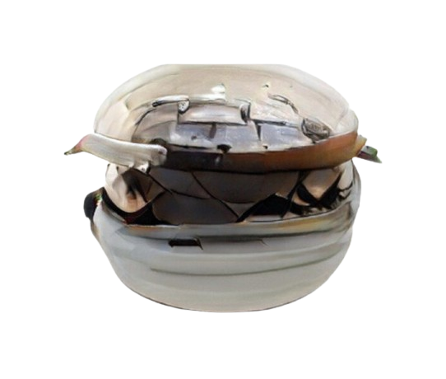
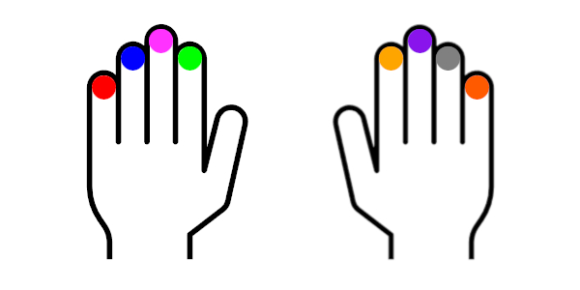
Trial
Another object will be presented. Please press the corresponding object key as quickly as possible.
This is the end of the instructions and in the following the experiment begins.
Example:
Press this key
Time

Slide 11
Task Start
Now the experiment begins!
Please place your fingers now on the keys in the arrangement shown below!
Check: The left and right index fingers are placed on the “F” and “H” key respectively.
Reminder:
Your task is to press the answer key of the presented object as quickly as possible
when the object is displayed.
The corresponding answer key is marked with the object, as in the picture below.
S
D
F
H
J
K
A
L
Press the space bar to start!

